Slide 1
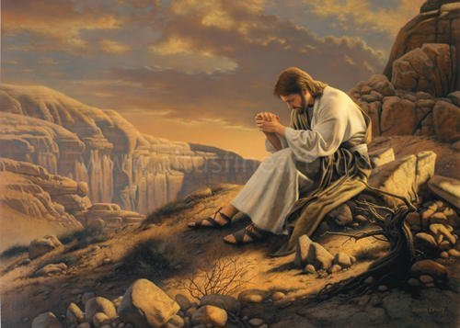
Praying with Jesus the Master

Slide 2
Moses – intercessory prayer
Elijah – persistent prayer
David – trusting prayer
Jesus – living prayer

Slide 3
In the Gospel accounts there are at least 37 instances of Jesus praying

Slide 4
Key passages where Jesus demonstrates the heart and power of living prayer:

Slide 5
1. Jesus teaches about prayer in the sermon on the mount
(Matt. 6:5-15; 7:7-12)

Slide 6
2. Jesus teaches his followers to pray -
Matthew 6:9-13
Luke 11:1-4

Slide 7
3. Jesus prays for his followers -
John 17:6-26

Slide 8
4. Jesus gave examples of relational vs. showcase prayer
(Luke 18:9-14)
Notes:
There are, however, some warning signs to which we might want to pay attention.
Do I have an “I am speaking to God” voice? This may be a matter of upbringing. Nevertheless, none is needed, and such a change in voice can draw attention to the one praying—unless one is in an environment that expects it, in which case not changing the voice can draw attention.
Elegant words and lots of them. This may be a matter of gifting and natural oratory, but again none are needed.
Personal agenda. It’s hard to excuse this one. You pray according to what you want done and what others need to do to help it along.
Gossip. “Please God. Help Jane resist the temptation to keep seeing that guy.” Such public prayers are only fruitful if Jane is there and has asked for intercession on that subject.
Public prayer of any kind without a private prayer life. It is a given that if you are not speaking to the Father when you are alone, there is no good speaking to Him publicly.
Having pictured the Pharisee is such a bad light, one might be provoked to pray, "God I thank you that I am not like that Pharisee", whereas in fact by doing so one may be just like that Pharisee. But should we not be thankful and acknowledge those positive qualities and works which God has produced in us and through us? Shouldn't we thank God for what sanctification he has accomplished in us? And concerning despising others doesn't it say of the godly that they "despise a vile man" Ps 15:4 But there are some problems with focussing on our goodness in thanksgiving - even despite giving glory to God for it. One is that due to our sinful human nature provoking pride in us, we tend to overevaluate how good we are - especially in comparison to others. And as such we may not be dealing with sin in our lives, which prevents God from listening to us (Isaiah 59:1,2) Another thing is that we may underevaluate God's work in other people. Notice that the Pharisee puts down the tax collector. But while Ps 15:4 advocates despsing vile men, the very next thing it says is that the godly man "honors those who fear the LORD" and prior to that "casts no slur on his fellowman".

Slide 9
5. Jesus prays in the Garden of Gethsemane -
Matt. 26:36-46
Mark 14:32-42
Luke 22:39-46

Slide 10
5. Jesus prays on the cross –
In anguish
To forgive
In trust

Slide 11
We pray infrequently. For Jesus, prayer is central to every thought and action.

Slide 12
We pray “opening” and “closing” prayers. For Jesus, prayer was a 24/7 proposition.

Slide 13
We pray focused on the reactions of the people and
the world around us. Jesus focused on his Heavenly Father.

Slide 14
We pray expecting our prayers to
“fail.” Jesus
prayed believing God heard and responded to every word.

Slide 15
We pray within our own context.
Jesus prays within the context of God’s Kingdom.

